Slide 1
Understanding political Corruption in low income economies – Rohini Pande
Iain Conway

Slide 2
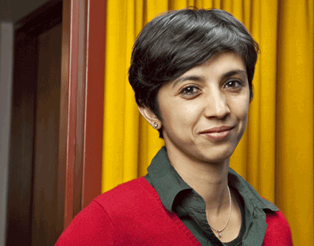
Rohini Pande
Born in Northern India
Education – Delhi, LSE and Oxford
Harvard
Collaboration with Banerjee, Duflo (MIT)

Slide 3
Overview
Introduction to corruption
Political Identity
The Political Environment
Implications for opportunities for corruption
Implications for the acceptance of corruption
Conclusions

Slide 4
Definition of Corruption
“Misuse of public office”

Slide 5
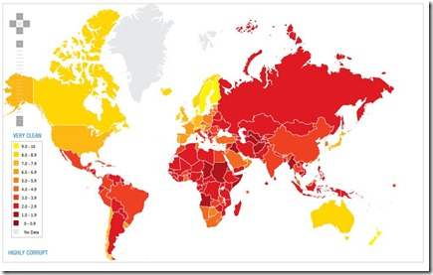
Stylized Fact?
Data?
Perception
Bribes paid

Slide 6
Political Identity
Downsian Model
Motivation of politician is electoral gains.
Citizen Candidate Model
Implements own preferences
If voters care about corruption, then no corruption will exist given perfect observation.
Policy aimed at median voter.
Voters care about honesty and policy preferences
Coordination failure leads to the corrupt taking power
Misuse of public office
Steal resources
Buy votes
Misallocate resources
Definition of corruption

Slide 7
Political Environment of developing countries
Political Environment
Opportunities for corruption
Acceptance of corruption

Slide 8
Political Environment of developing countries
Rural population
Ethnic diversity
Politicians have above average wealth
Business interests
Gender inequality

Slide 9
Opportunities for corruption
Power and networks
Ethnicity and gender
Public allocation of resources and regulation
Information

Slide 10
Acceptance of corruption
Redistributive Preferences
Greater need for redistribution of wealth.
Change in redistribution with political change.

Slide 11
Redistributive preferences

Slide 12
Acceptance of corruption
Participation
Participation reduces corruption
Income & education
Gender
Voter turnout
Ethnic diversity

Slide 13
Political participation

Slide 14
Acceptance of corruption
Monitoring
Rich and educated better able to punish.
No price discrimination found. Flat tax - Rich found to pay same bribes.
Court costs, better monitoring.

Slide 15
Conclusions
Developing countries more prone to corruption.
Political and economic differences between developing countries and developed countries appear to lead to increased corruption.
Aid should be conditional on institutional improvement, not simply withdrawing aid to punish individuals.

